Slide 1
Introduction to nosql

Slide 2

Introduction

Slide 3

Introduction

Slide 4

Introduction

Slide 5

Introduction

Slide 6
Introduction
MongoDB is one of the most accepted NoSQL database and stores data in a JSON structure.

Slide 7
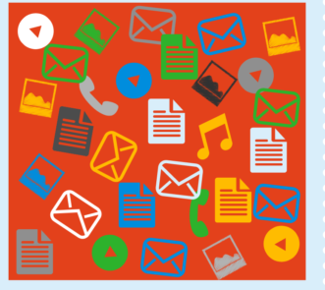
What is nosql database
Managing massive collection of unstructured data

Slide 8
Where this NoSQL term came ?
non SQL
nonrelational

Slide 9
What kind of issues relational database are unable to solve?
A dynamic change in the nature of data - i.e., nowadays data are in structured, semi-structured, nonstructured as well as polymorphic in type.

Slide 10
What kind of issues relational database are unable to solve?
A dynamic change in the nature of data - i.e., nowadays data are in structured, semi-structured, nonstructured as well as polymorphic in type.
The variety of applications and the type of data feed into them for analysis has now become more diverse and distributed and is approaching cloud-oriented.

Slide 11
What kind of issues relational database are unable to solve?
3. Also, modern applications and services are serving tens of thousands of users in diverse geo-locations, having diverse time zones. So data integrity needs to be there at all the time.

Slide 12
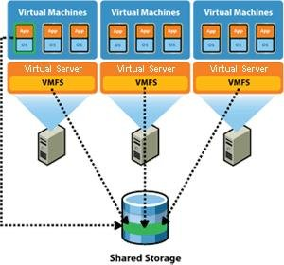
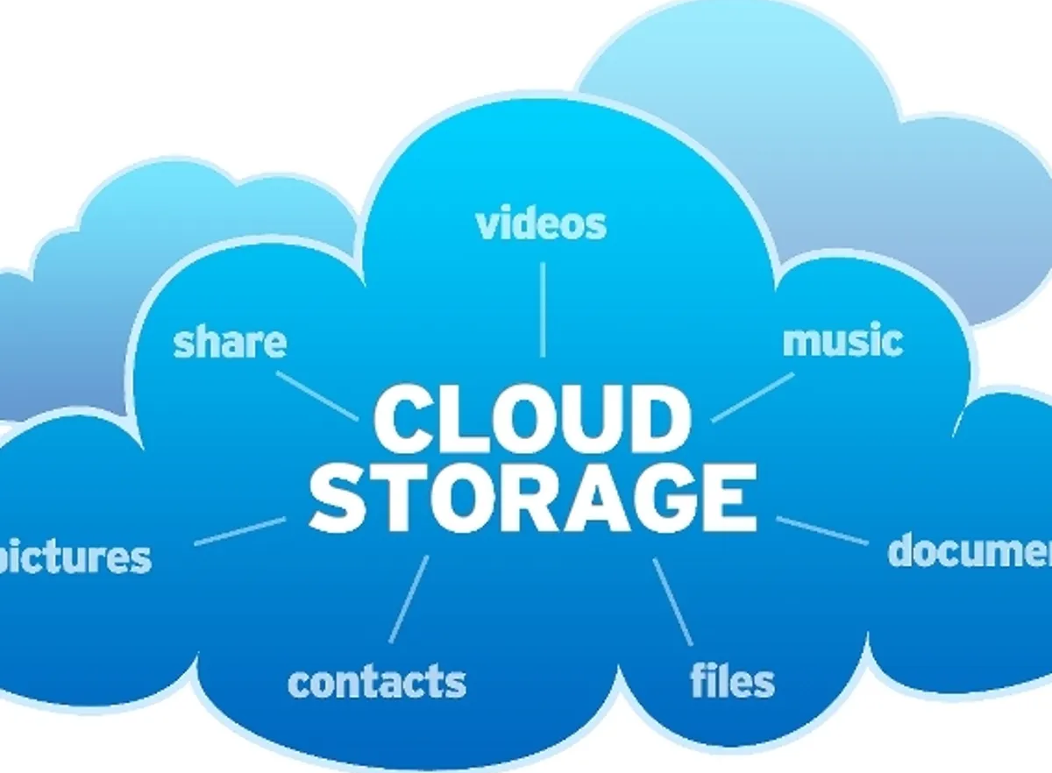
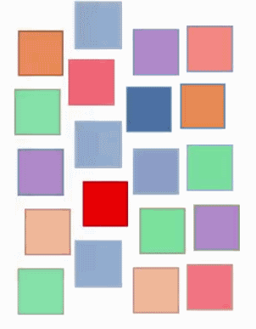
What kind of data can be easily analysed by nosql?
multiple virtual servers

Slide 13


NOSQL is intented to overcome the :-
Modelling of data
Diversity of data
Increase

Slide 14

NOSQL is intented to overcome the :-
Distribution
Scalability of data

Slide 15
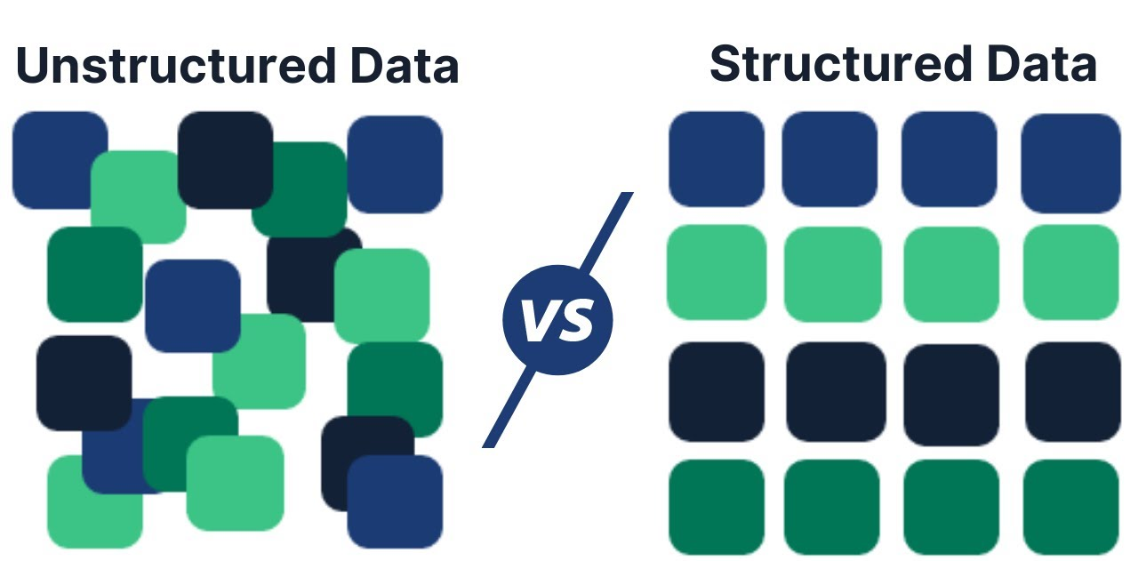
Structured vs unstructured data

Slide 16
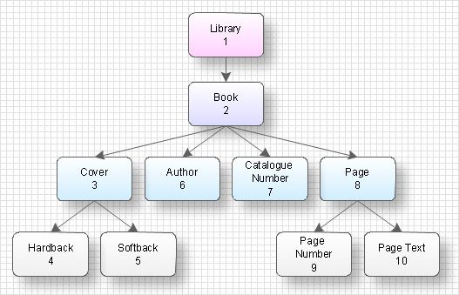
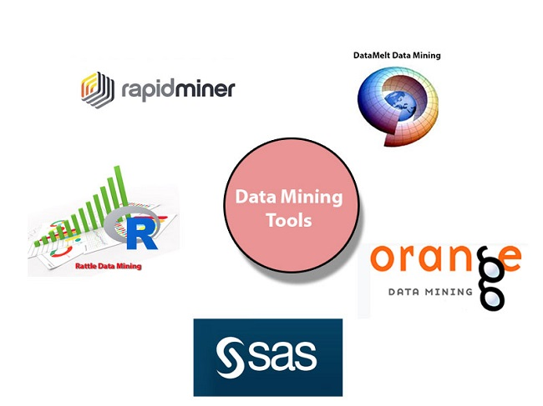
Structured vs unstructured data
Structured data are in a proper format, usually text files or which can be represented in a tabular format.
chart-like form
Data mining tool

Slide 17
Structured data

Slide 18
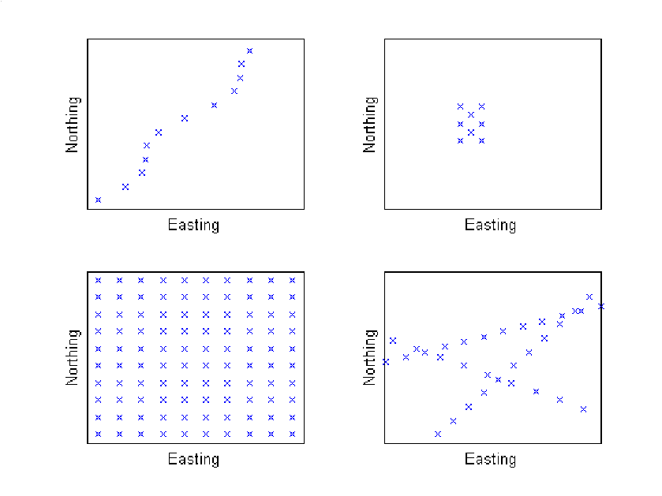
unstructured data
Haphazard data format

Slide 19

unstructured data
Haphazard data format
Document file

Slide 20
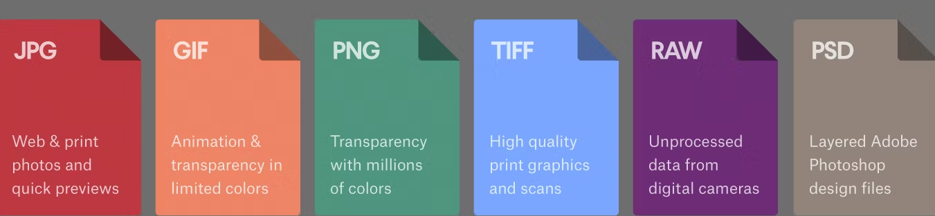
unstructured data
Image file
Haphazard data format
Document file

Slide 21

unstructured data
Image file
Haphazard data format
Video files
Document file

Slide 22

unstructured data
Image file
Haphazard data format
Video files
Document file
Icons

Slide 23
unstructured data
Modern-day data generated from different applications, services, or sources are a combination of structured and unstructured both.
So, you will need something to store such data to make your application work properly. NoSQL based languages and scripts can help in this regard.

Slide 24
Difference between structure and unstructured data
Structured Data | Unstructured Data
It is based on a relational database. | It is based on character and binary data.
Structured data is less flexible and schema-dependent. | There is an absence of schema, so it is more flexible.
It is hard to scale database schema. | It is more scalable.
It is very robust. | It is less robust.
Here, we can perform a structured query that allows complex joining, so the performance is higher. | While in unstructured data, textual queries are possible, the performance is lower than semi-structured and structured data.
Structured data is quantitative, i.e., it consists of hard numbers or things that can be counted. | It is qualitative, as it cannot be processed and analyzed using conventional tools.
It has a predefined format. | It has a variety of formats, i.e., it comes in a variety of shapes and sizes.
It is easy to search. | Searching for unstructured data is more difficult.

Slide 25
Types of databases in NoSQL
Types of databases in NoSQL
Document type databases
Key-Value stores
Graph stores
Wide-column stores:

Slide 26
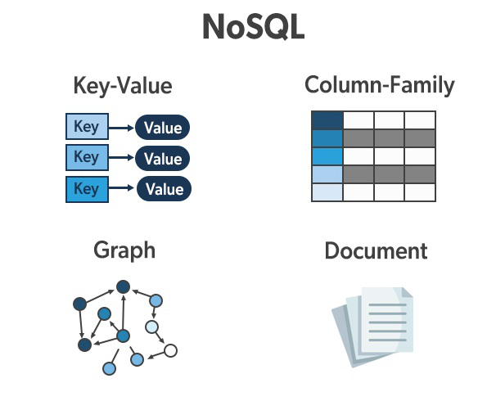
Document Type Database

Slide 27
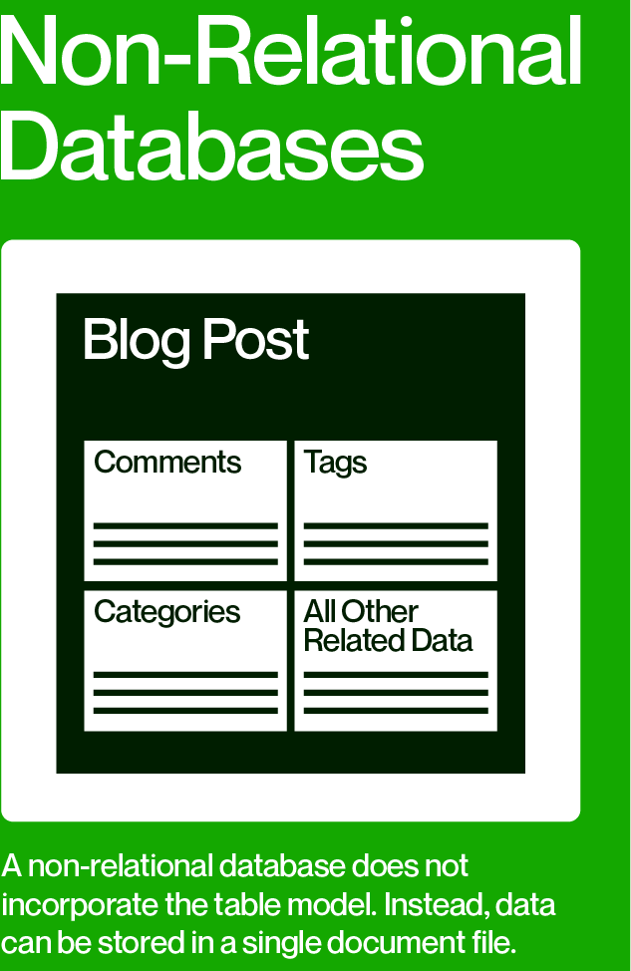
1
Document Type Database

Slide 28
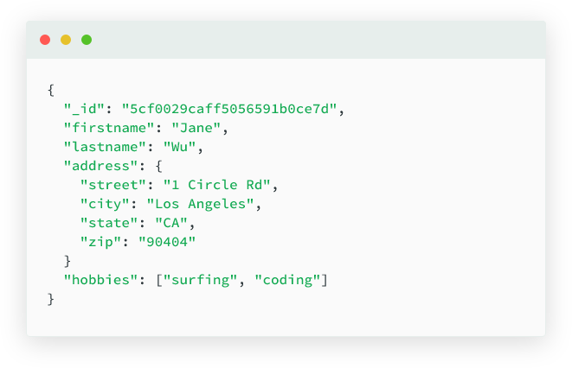
2
Document Type Database

Slide 29
3
JSON
BSON
XML
Document Type Database

Slide 30
4
Elements can be accessed by using the index value
Document Type Database

Slide 31
Key features of documents database:
Flexible schema
Faster creation and maintenance
No foreign keys
Open formats
Document Type Database

Slide 32
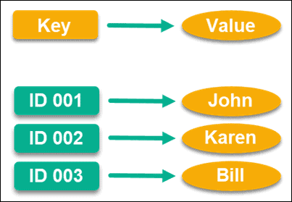
Key-Value Stores
1. nonrelational database
2.

Slide 33
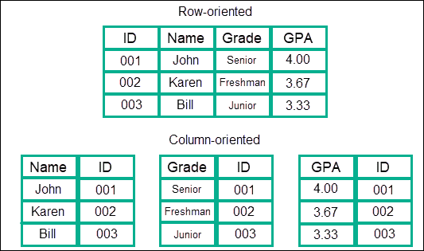
Column oriented database
2.

Slide 34
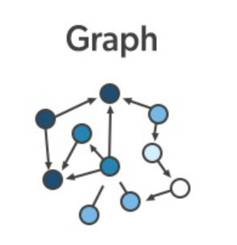
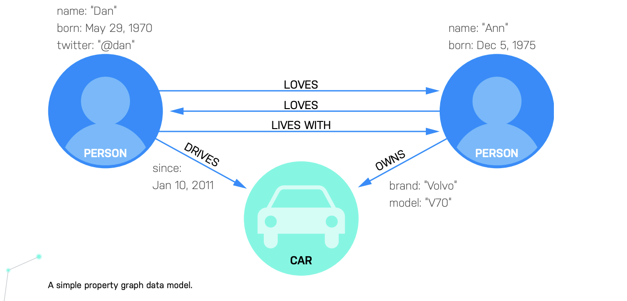
Graph based database
2.

Slide 35
Benefits of NOSQL DATA TYPE
It allows developers to create large volumes of structured, semi-structured as well as unstructured data for making the application diverse and not restricting its use because of the type of data being used within the application.
It also allows agile development; rapid iteration along with frequent code pushes, which makes it more popular.
It can be used with object-oriented programming (OOP), which makes it easy to use with flexibility.
Data can be stored more efficiently, making it less expensive, providing massive architecture.

Slide 36
Benefits of NOSQL DATA TYPE
NoSQL Database is a more simpler and easy to use database server, when compared to those of relational databases.
NoSQL Database facilitates fast data storage and retrieval functionalities

